Slide 1
M-17 (Tolminski Migovec)
Cadastral number 5878 Explored 27.08.1983
https://www.katasterjam.si/Caves/Details/5878

Slide 2
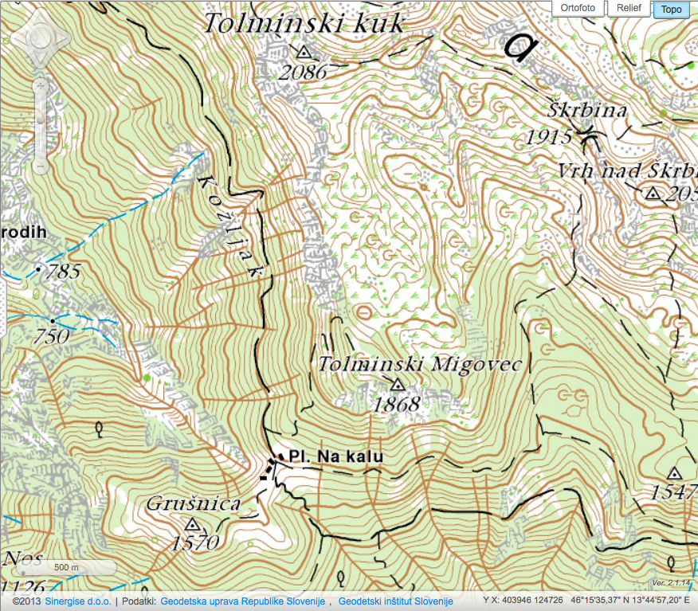
M-17 (Tolminski Migovec)
Caving hut
Planina Kal

Slide 3
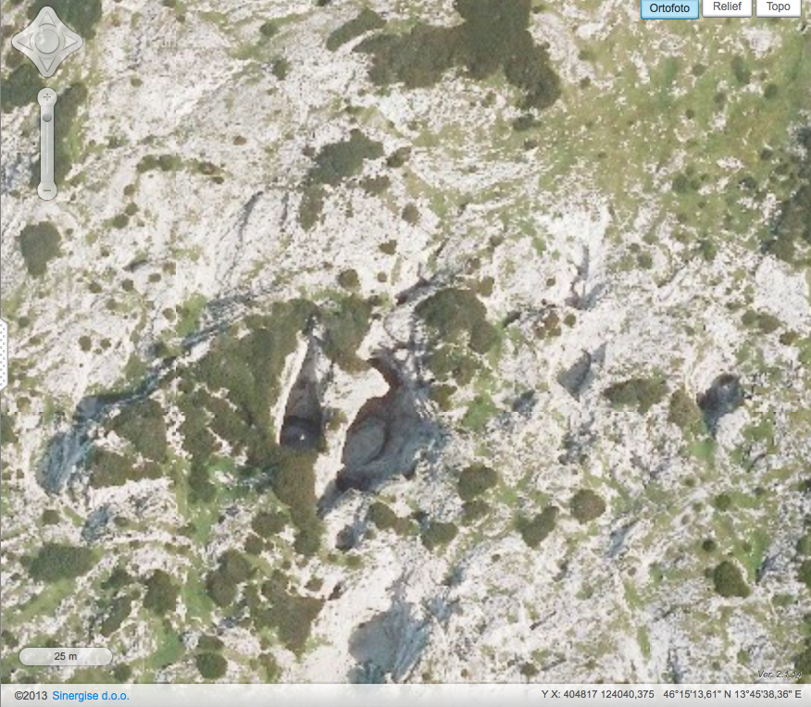
access shaft to M17
new shakehole entrance
opened up 10/2018

Slide 4
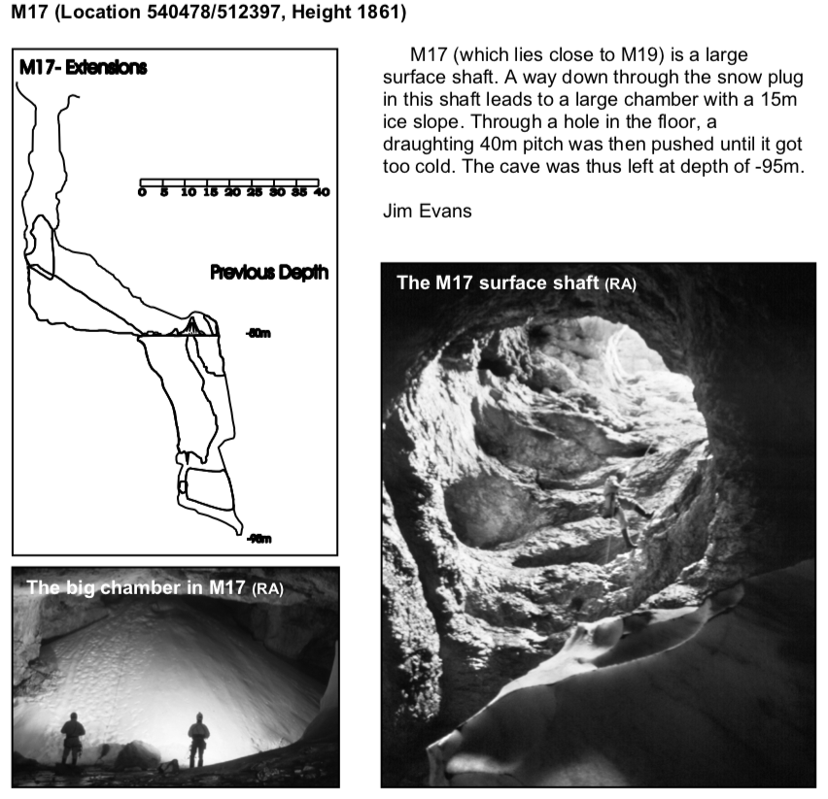
1983 - first exploration by JSPDT
1990 - included on the Slovene cadaster
1994 - revisited and surveyed by ICCC
1994-2017 - occasional tourist + photo trips
2018 - resurvey by ICCC+JSPDT and wood sampling

Slide 5
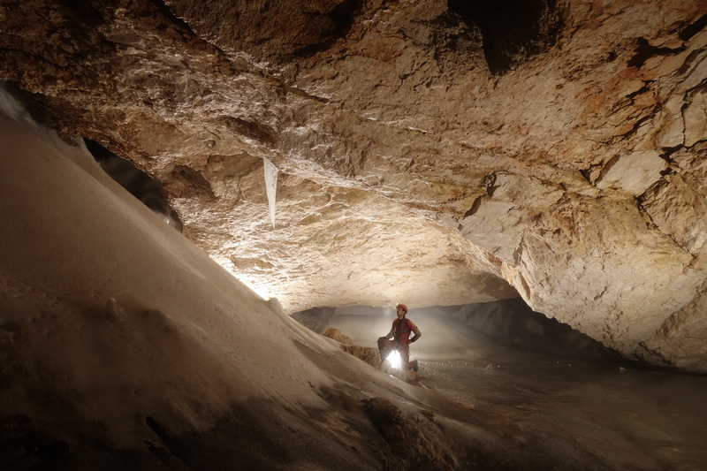
Ice/snow changes
Logger 475 (at back of ice room)
Snow from M19 shakehole (open connection since 10/2018)
Way down to ice shaft
Photo - 07/2017.

Slide 6
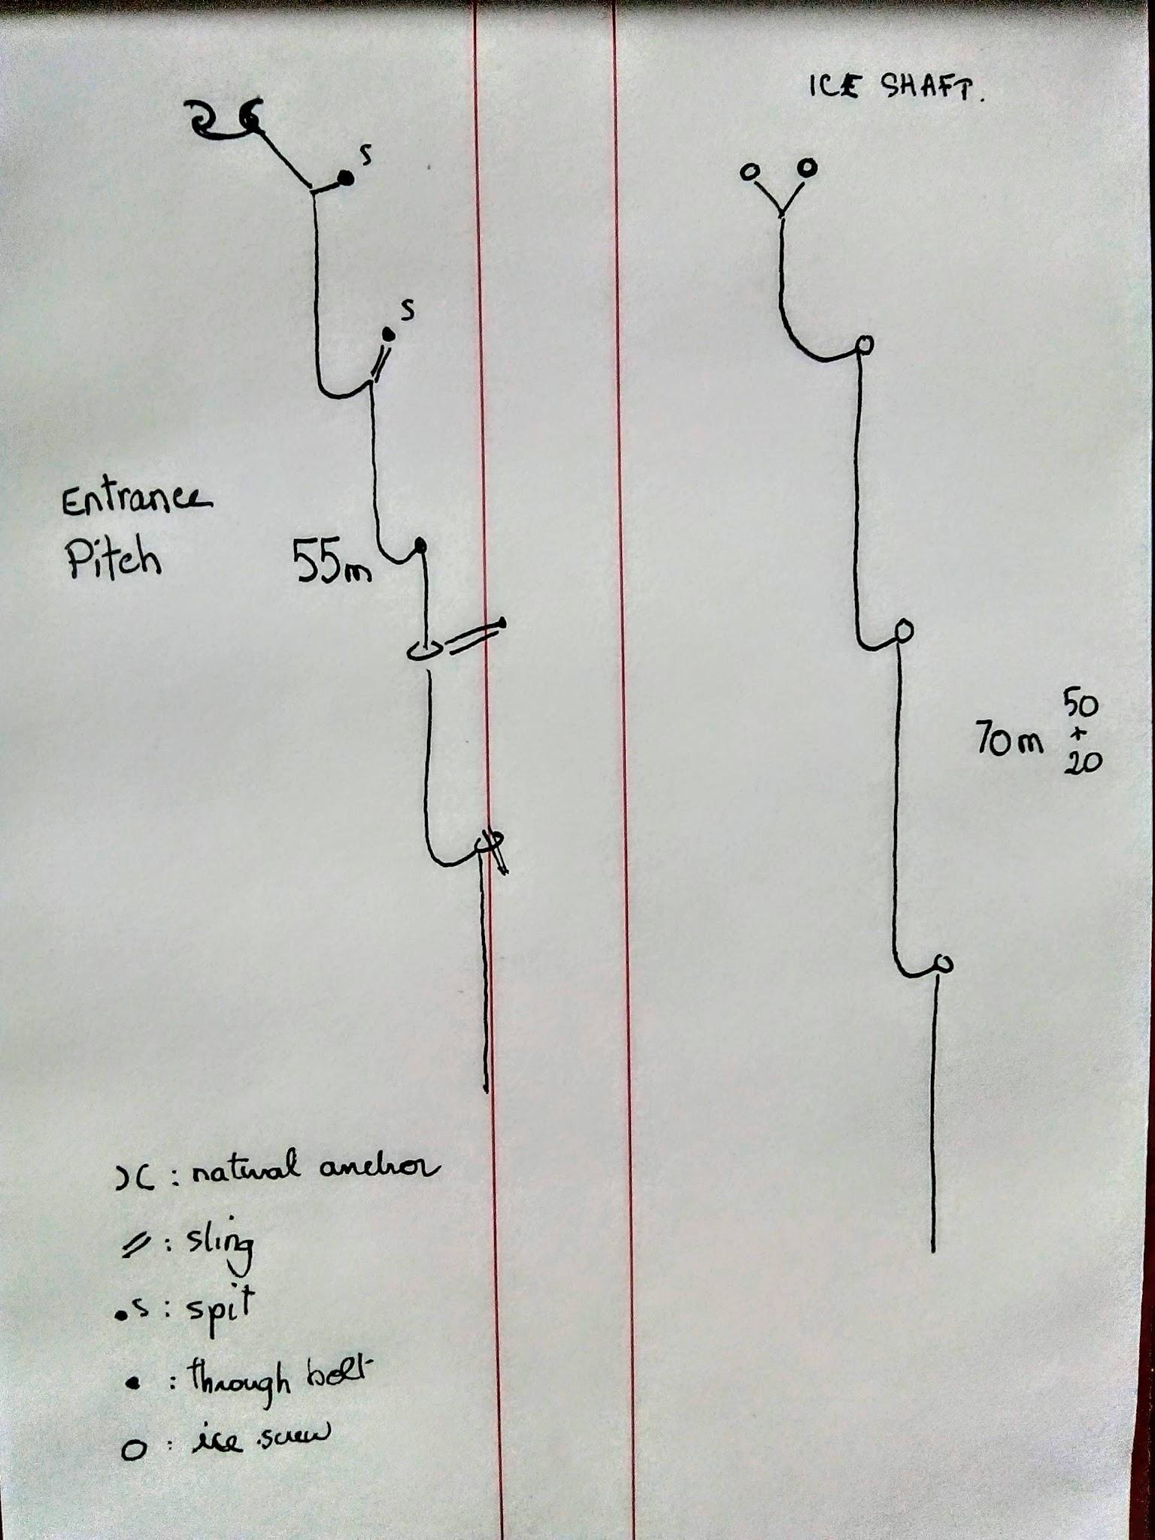
Rigging
Entrance pitch
3 slings
2 spit hangers+bolts
1 karabiner
3 maillons
55m rope
Ice shaft
5 maillons
5 ice screws
70m rope (50 + 20)

Slide 7
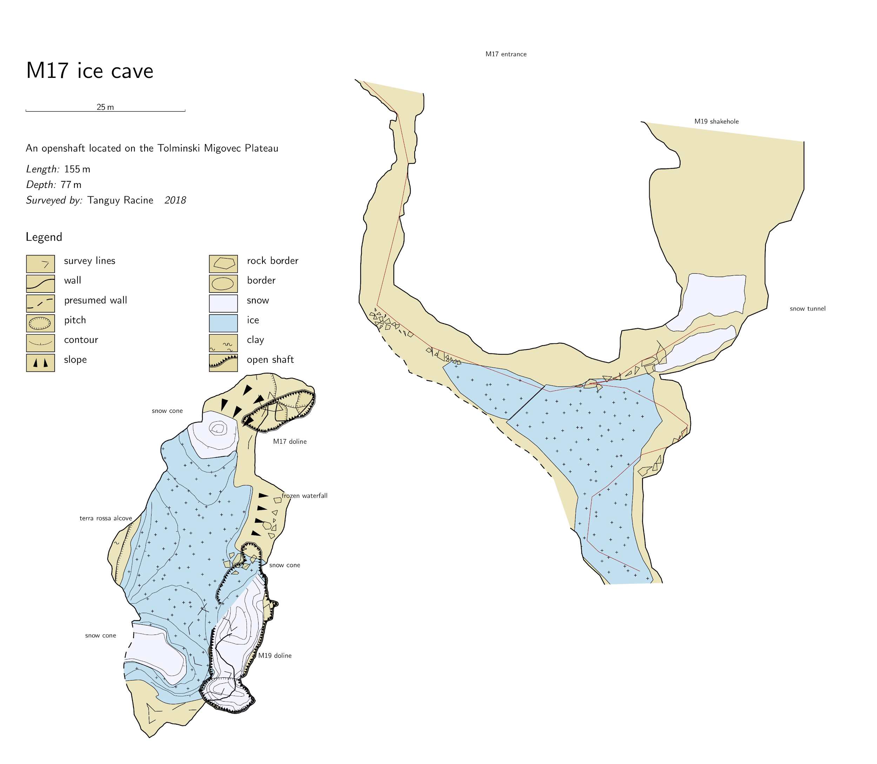
2018 survey
new shakehole entrance
three snow plugs feeding the ice
Survey work in progress.
(24. Oct 2018)

Slide 8
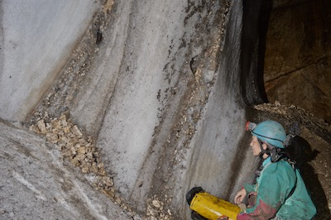
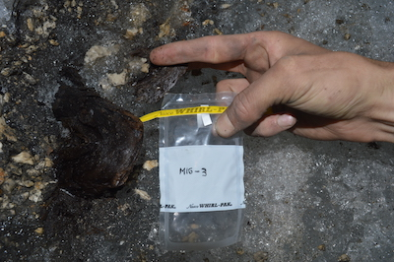
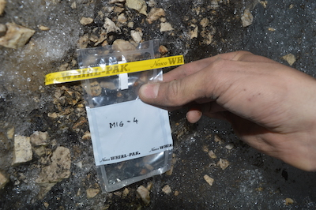
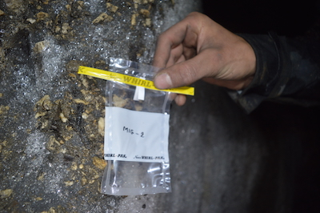
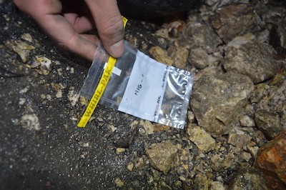
Samples

Slide 9
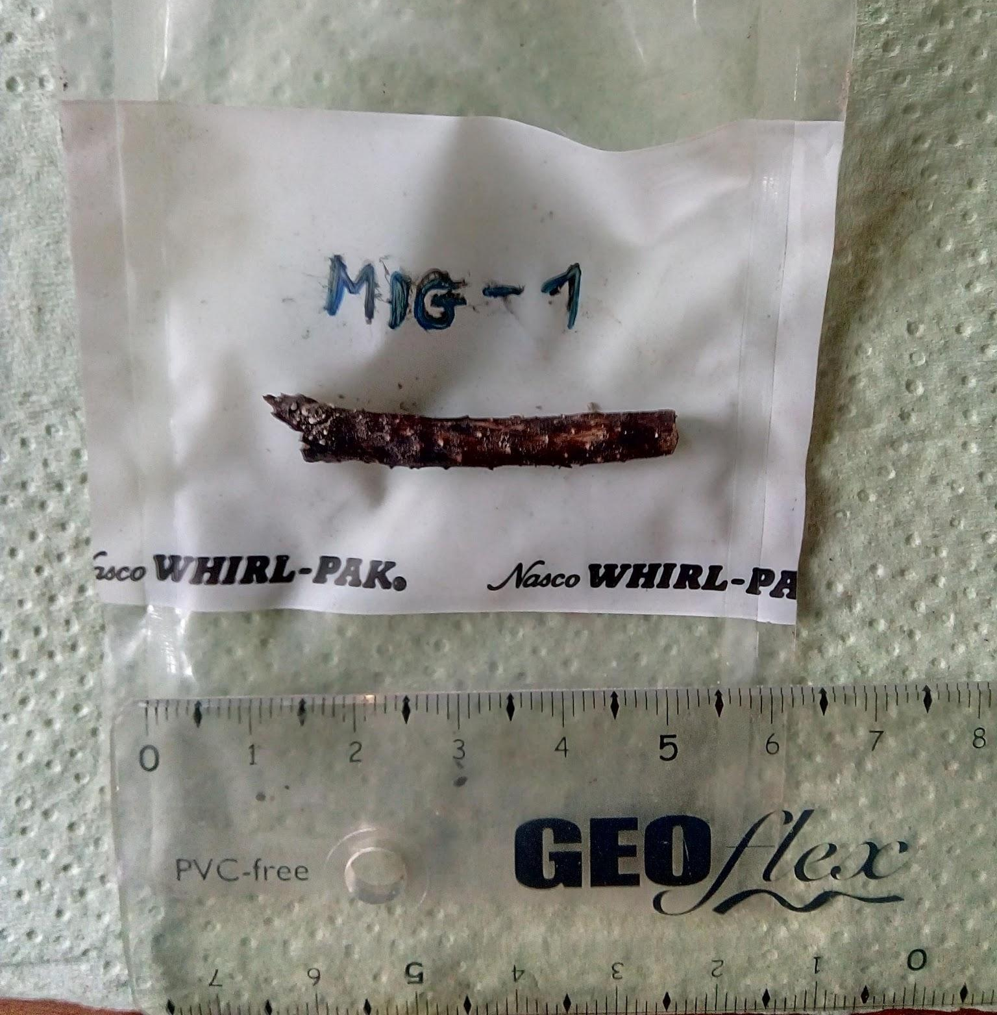
MIG-1

Slide 10
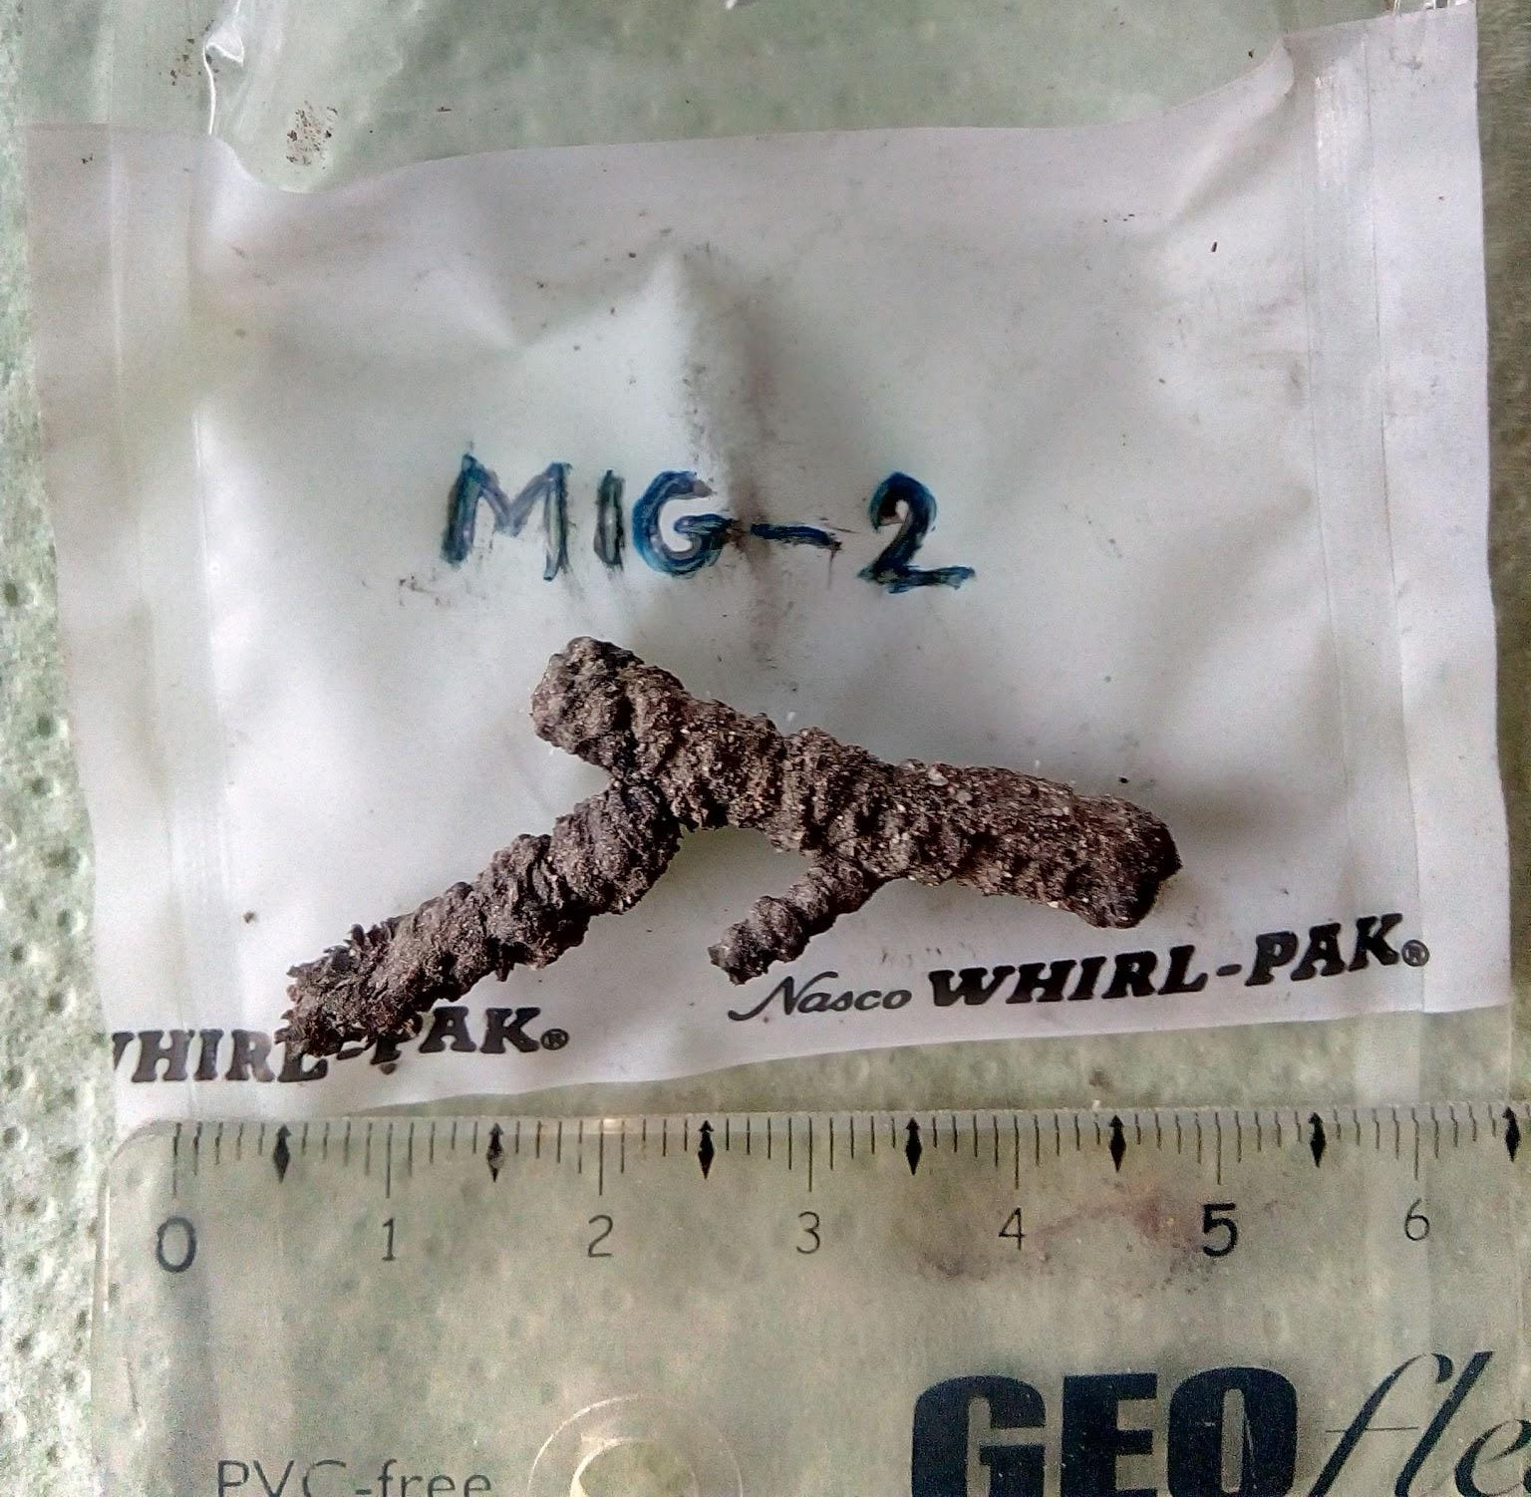
MIG-2
Dwarf pine twig
Age?

Slide 11
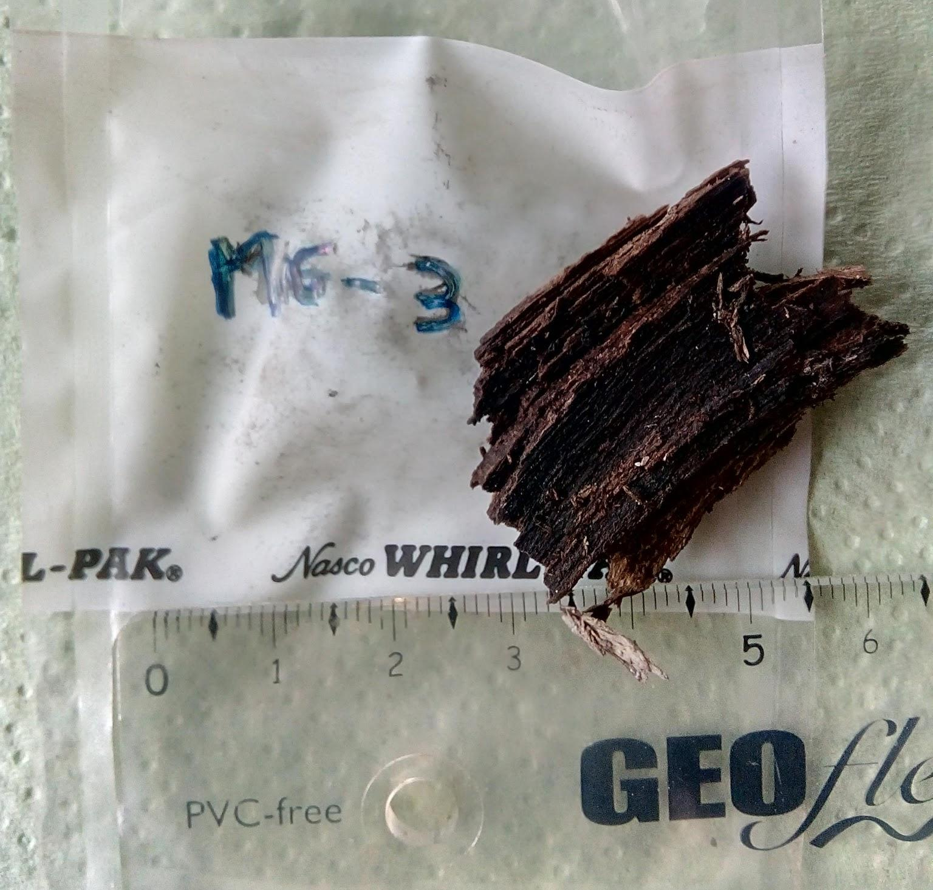
MIG-3

Slide 12
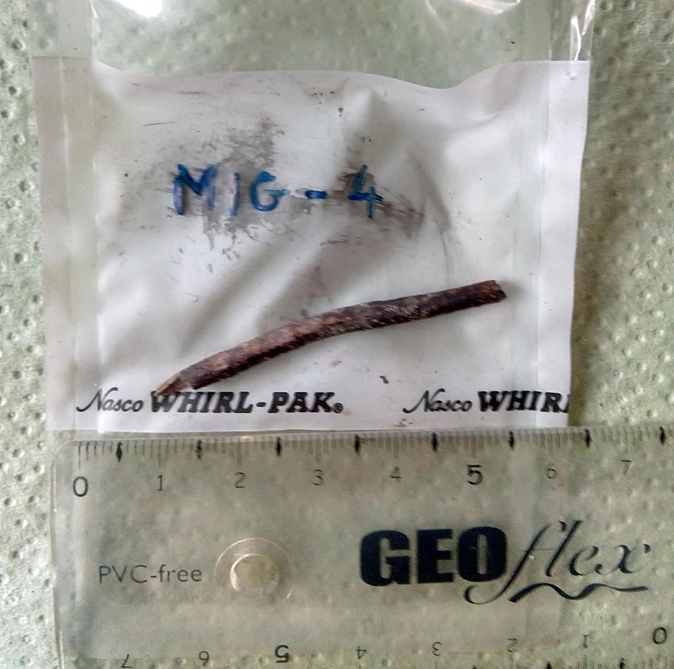
MIG-4

Slide 13
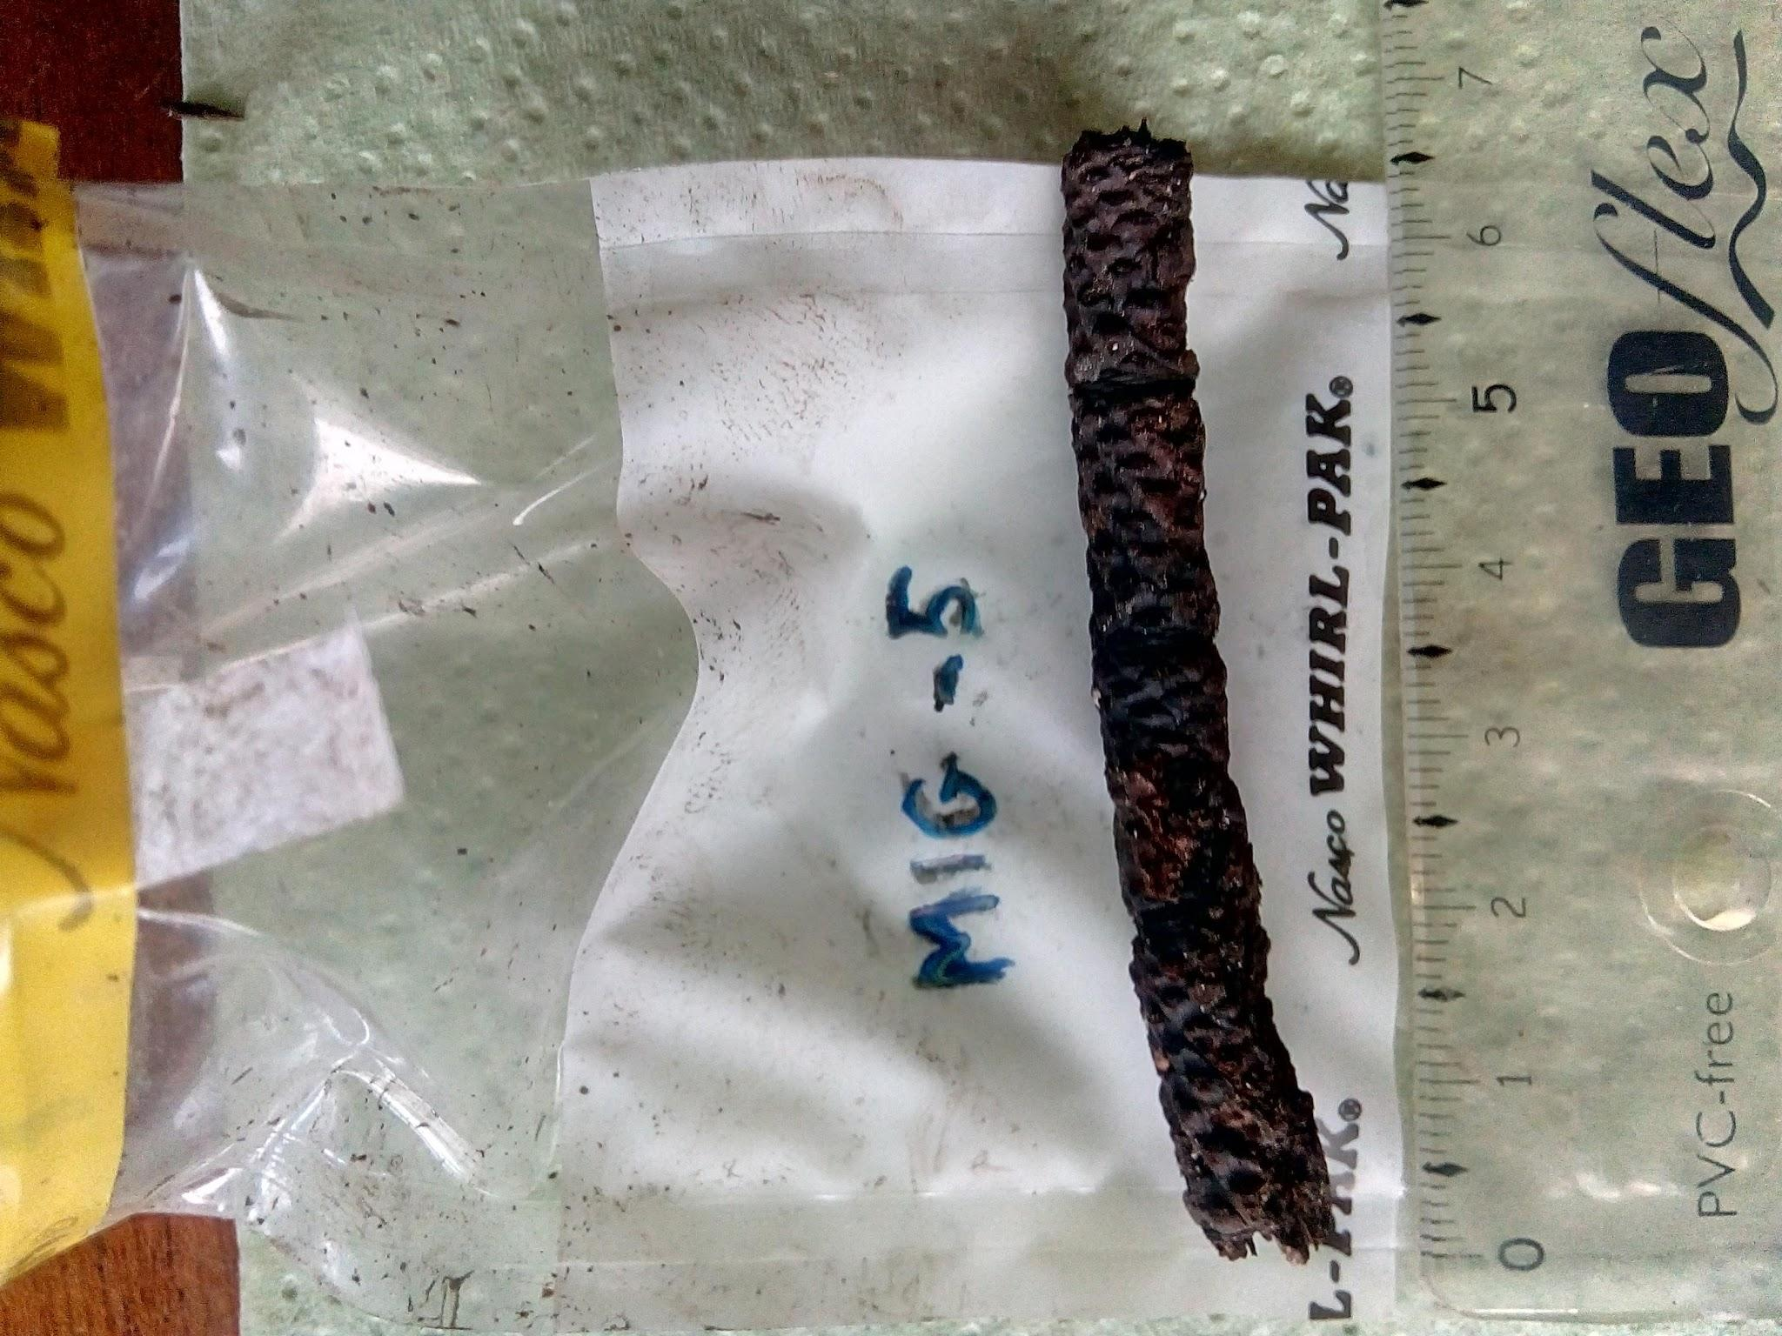
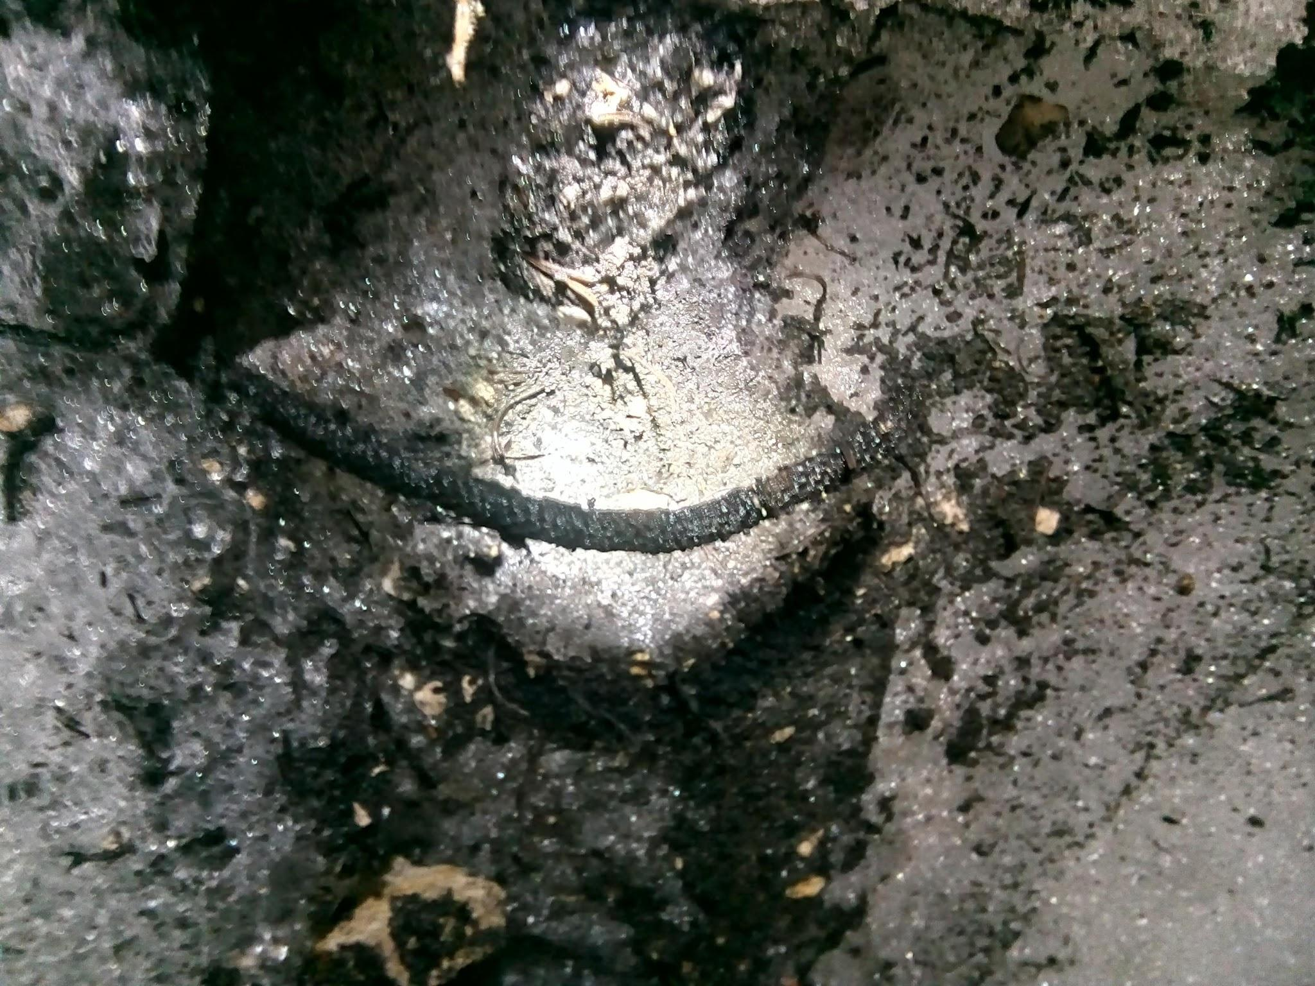
MIG-5
Dwarf pine twig

Slide 14
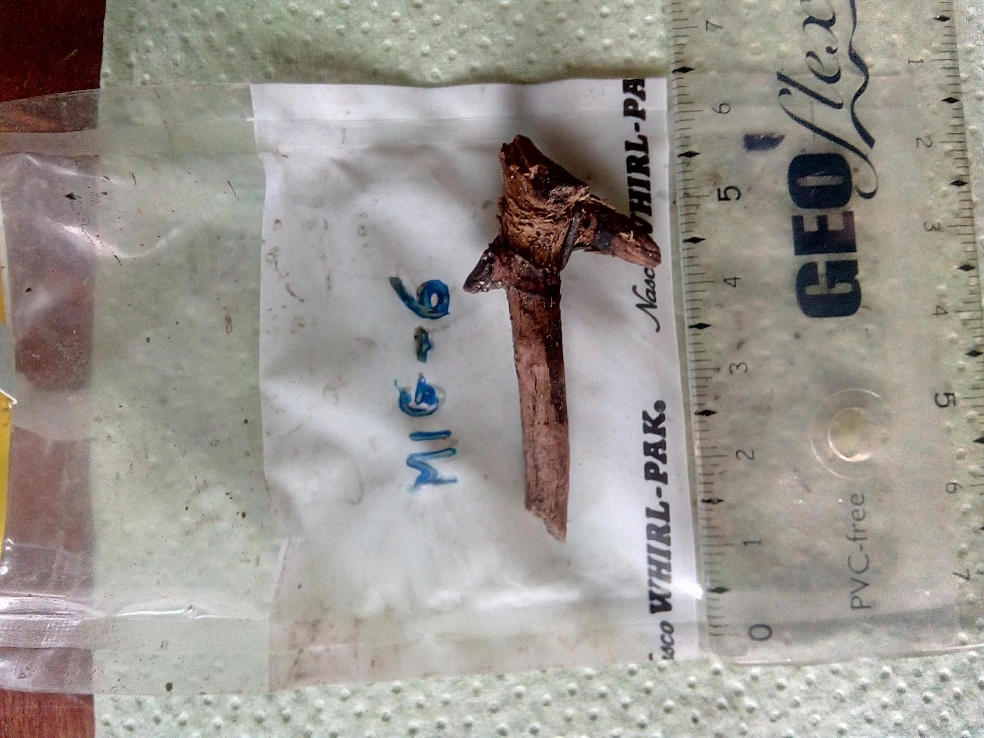
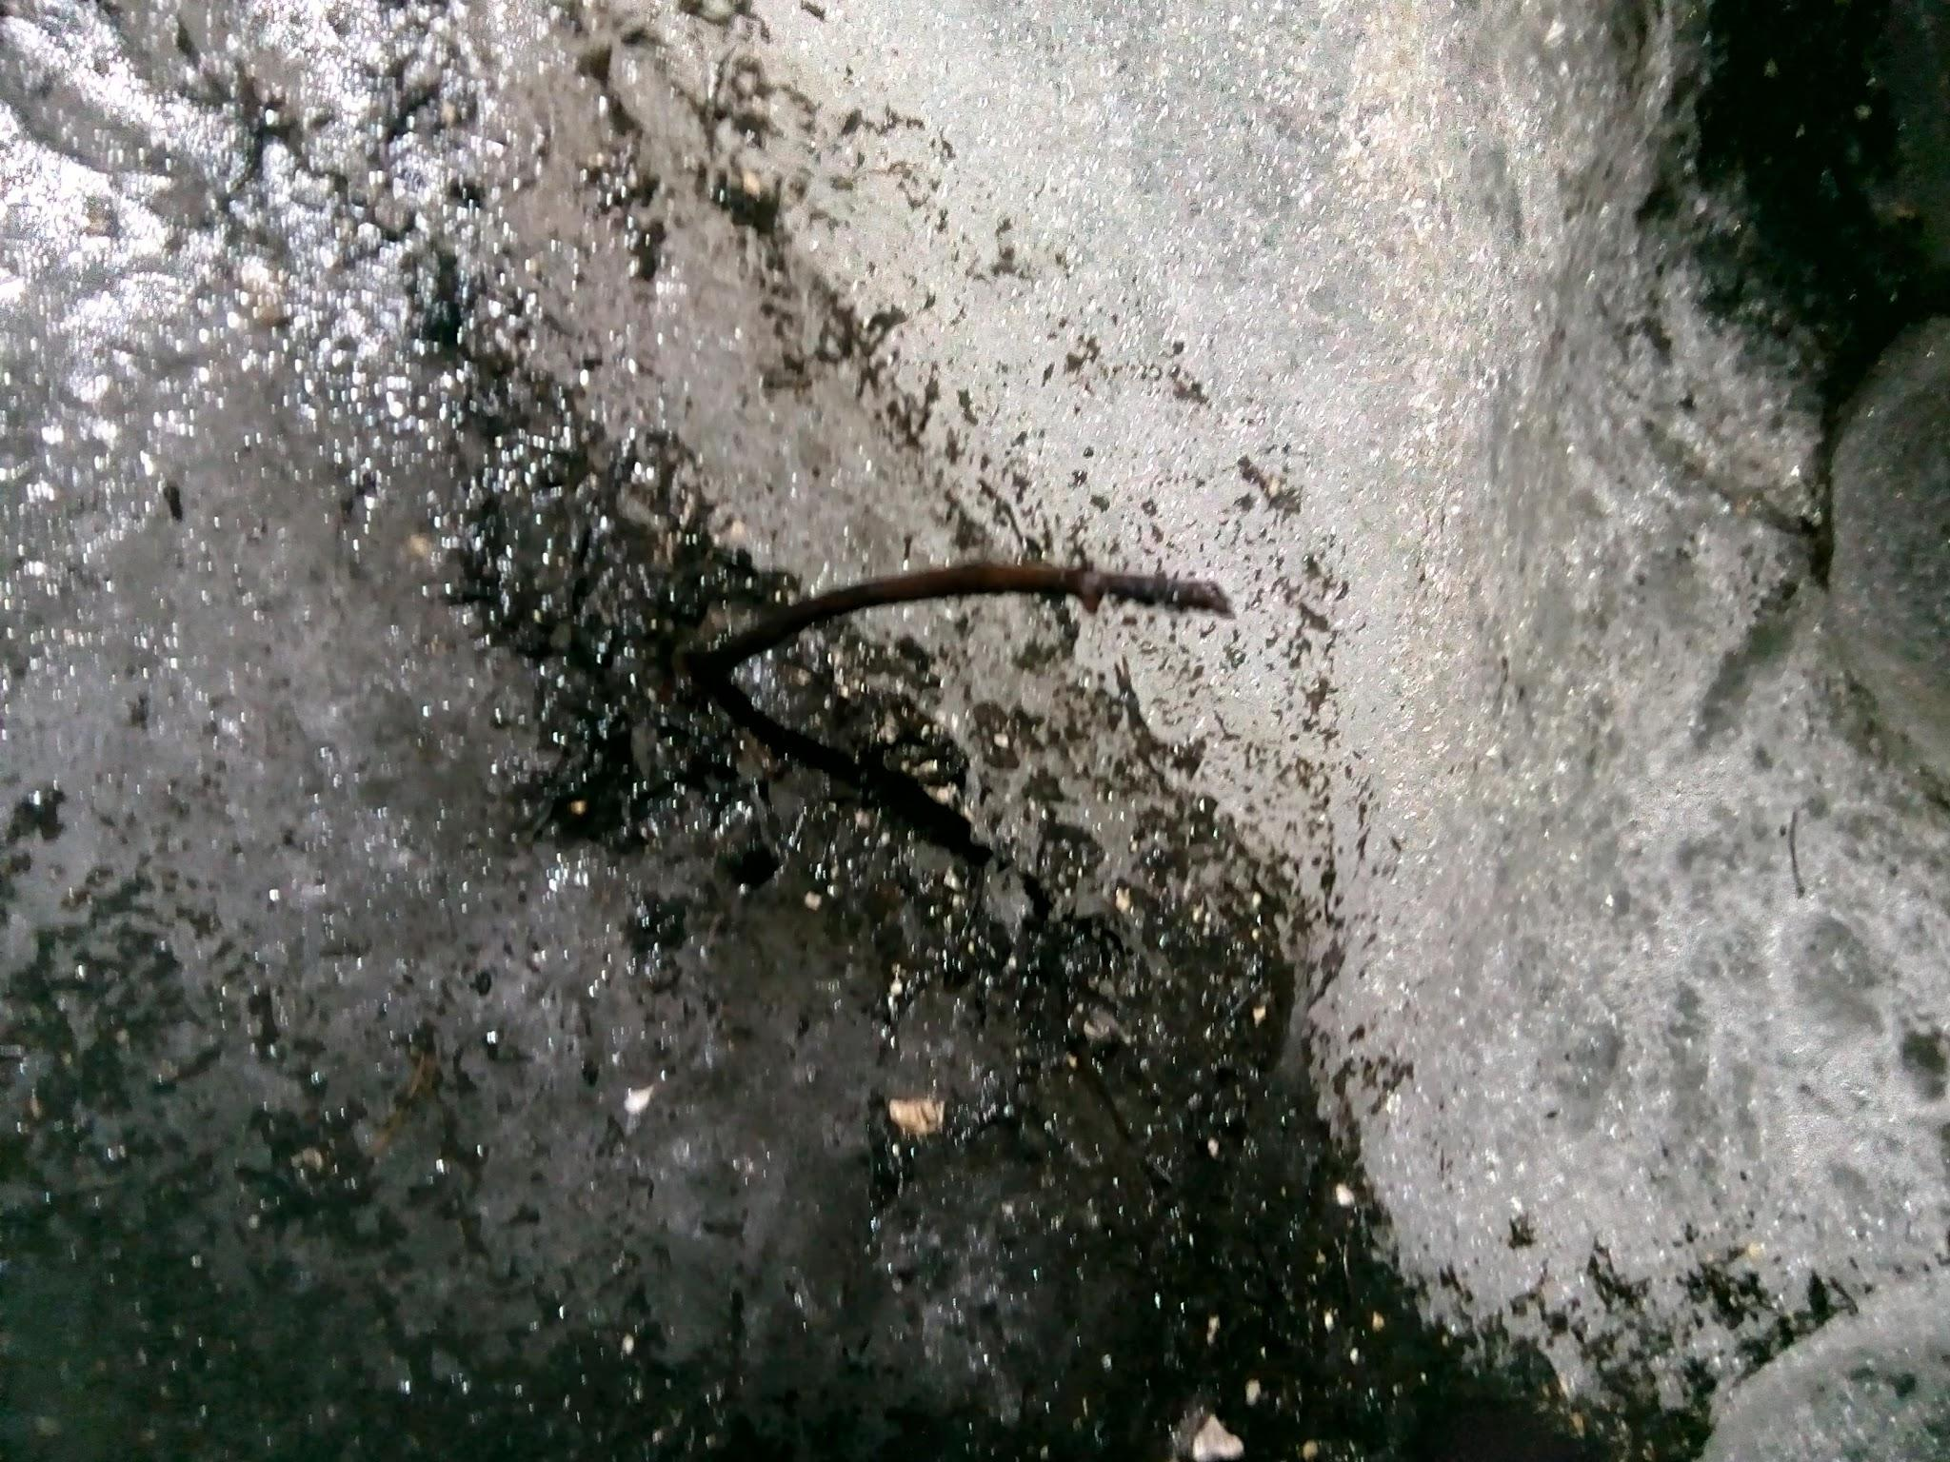
MIG-6

Slide 15
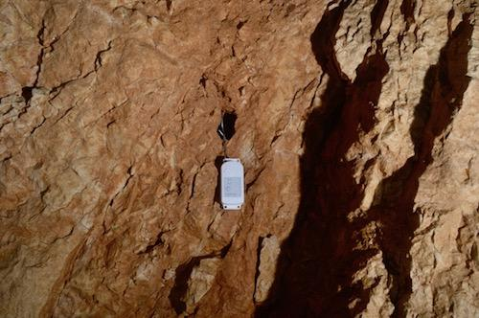
Logger 473 - HOBO - internal sensor
Situation: alcove at bottom of entrance pitch

Slide 16
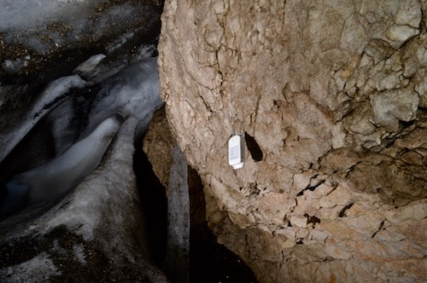
Logger 475 (HOBO internal sensor)
Situation: back of the ice room

